Slide 1

Recommendation IN Practice
COLLABORATIVE FILTERING FOR IMPLICIT FEEDBACK DATASETS
PRESENTED BY:
Xie Guohuan/解国欢
2020-07-24

Slide 2
OUTLINE
General Introduction Of Recommendation
Different Types Of Recommender System Models
Recommendation Algorithm Challenges
Collaborative Filtering For Implicit Feedback Datasets
Implicit Feedback Datasets
What Is Collaborative Filtering:Neighborhood-Models VS Latent Factor Models
Preference and Confidence
Alternating Least Squares Optimization
Deployment and Online Prediction
Conclusions

Slide 3


35 % of amazon revenue is from recommendation engine
Recommendation algorithms are best known for their use on e-commerce websites where they use input about a customer’s interests to generate a list of recommendation items.
INTRODUCTION

Slide 4

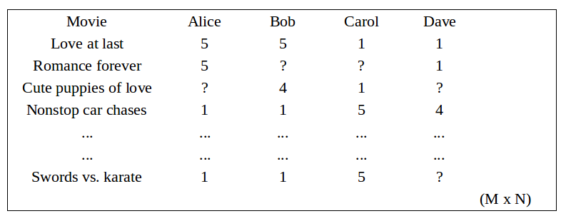
Predicting Problem
INTRODUCTION
Notes:
Recommendation problem usually can be formulated as two kinds of problem:
The first one is predicting problem,the second on is ranking problem;

Slide 5

Ranking Problem
INTRODUCTION
Notes:
Recommendation problem usually can be formulated as two kinds of problem:
The first one is predicting problem,the second on is ranking problem;

Slide 6




1. Collaborative Filtering Models
Content-Based Recommender Systems.
Knowledege-Based Recommender Systems.
Hybrid and Ensemble-Based Recommder Systems.
DIFFERENT TYPES OF RECOMMENDER SYSTEM Models
Notes:
Many collaborative filtering models focus on leveraging either inter-item correlations or inter-user correlations we have strong belief that user who bought many same items are similar and then woud like each other’s choice and items which appear both at user’s baskets frequently are inter-related.
Content-based recommendation models 倾向于利用用户的购买行为以及对应的产品的描述以及属性信息为用户做推荐，该推荐算法对新物品比较友好；
基于知识的推荐主要依赖的是用户对产品的需求信息，比如买房时，限制的价格，地段，学区等需求与产品本身的相似度做推荐，这种推荐算法不依赖与用户与产品的历史交互行为，比如淘宝的拍照搜索；
最后一种是集成推荐系统，利用各种推荐数据源以及各个推荐系统来产生最优的推荐结果，正所谓，三个臭皮匠，顶个诸葛亮；

Slide 7







OLDER CUSTOMER CAN HAVE A GLUT OF INFORMATION BASED ON THOUSANDS OF PURCHASES AND RATINGS.
A LARGE RETAILER MIGHT HAVE HUGE AMOUNTS OF DATA, TENS OF MILLIONS OF CUSTOMERS AND MILLIONS OF DISTINCT CATALOG ITEMS.
MANY APPLICATIONS REQUIRE THE RESULTS SET TO BE RETURNED IN REAL TIME, IN MORE THAN HALF A SECOND WHILE STILL PRODUCING HIGH QUALITY RECOMMENDATIONS.
NEW CUSTOMERS TYPICALLY HAVE EXTREMELY LIMITED INFORMATION BASED ON ONLY A FEW PURCHASES OR PRODUCT RATINGS.
CUSTOMER DATA IS VOLATILE: EACH INTERACTION PROVIDES VALUABLE CUSTOMER DATA, AND THE ALGORITHM MUST RESPOND IMMEDIATELY TO THE NEW INFORMATION.
RECOMMENDATION ALGORITHM CHALLENGES

Slide 8
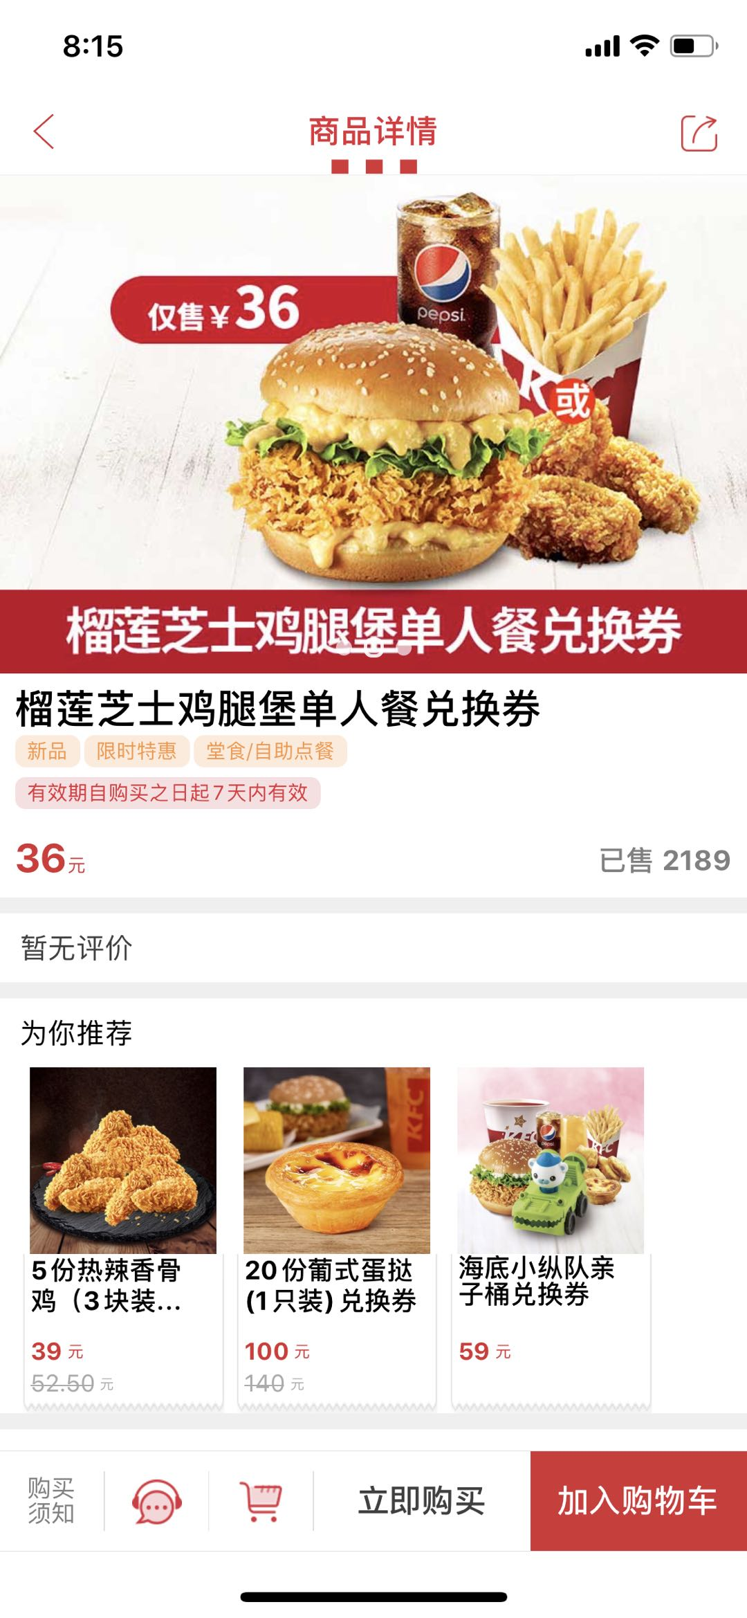
BUSINESS SCENE AND OUR GOAL

Slide 9
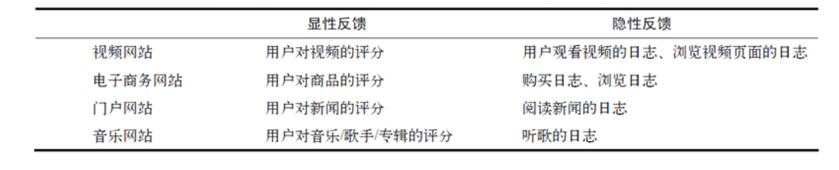
Explicit Feedback VS Implicit Feedback

Slide 10
Unique Characteristic Of Implicit Feedback
No Negative Feedback
Implicit Feedback Is Inherently Noisy
The Numerical Value Of Explicit Feedback Indicates Preference Whereras The Numerical Value of Implicit Feedback Indicates Confidence
Evaluation of Implict Feedback Recommender Requires Appropriate Measures

Slide 11
What Is Collaborative Filtering
Can Be Formulated AS Matrix Completion Problem

Slide 12
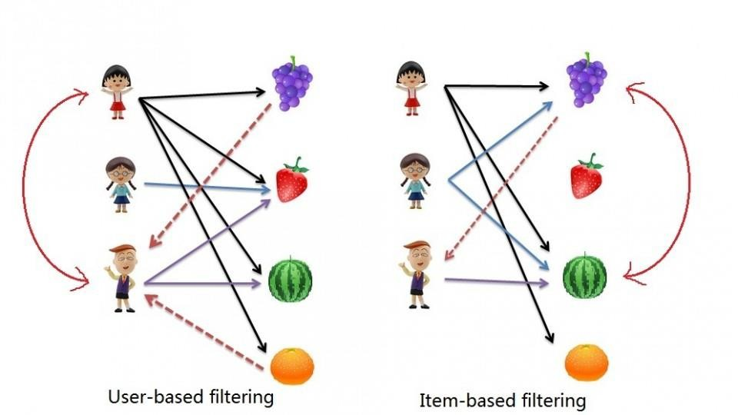
Neighborhood-Based Models
Notes:
Collaborative Filtering:
significant dependencies between user and item-centric activities;
Recommendations is always based on previous interaction between users and items,because past interests are good indicators of future choices.
Use observed ratings to predict unobserved ratings,then base on the ratings to rank items for user
Most of the collaborative filtering algorithm leverage either the item-item corelations or user-user corelations to make recommendation.
Some memory-based collaborative filtering algorithm can be expressed as regression model.

Slide 13
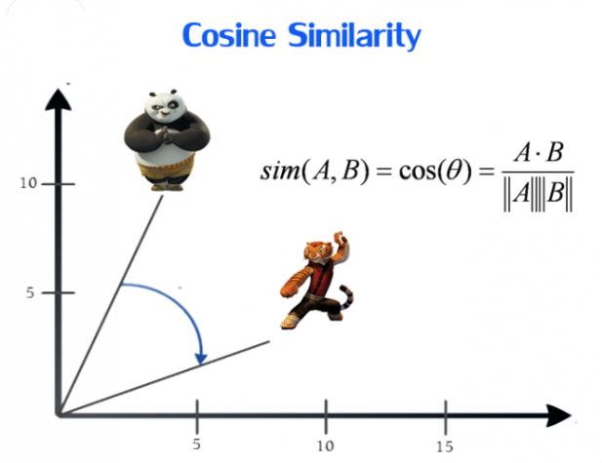

Slide 14
LIMITATIONS
Using collaborative filtering is computationally expensive
Worst case complexity is O(MN)[M- Number of customers, N-Number of product catalog].
The final performance of the algorithm is O(M+N).
The algorithm encounters severe performance and scaling issues.
We can reduce M and N by a large factor but with the cost of recommendation quality.

Slide 15
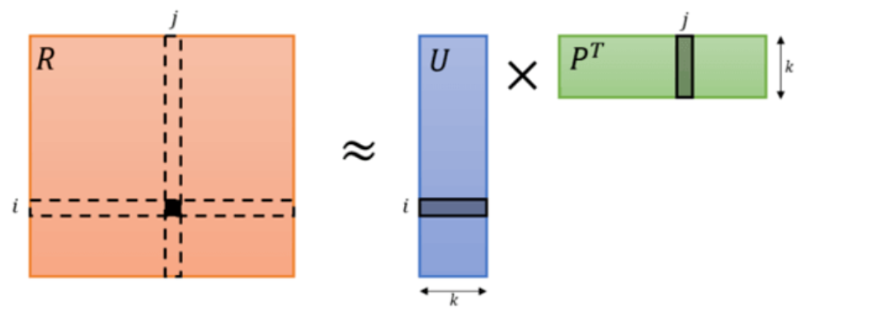
Latent Factor Models
Latent Factor
Notes:
基于矩阵分解的推荐算法的核心假设是用隐语义（隐变量）来表达用户和物品，他们的乘积关系就成为了原始的元素。这种假设之所以成立，是因为我们认为实际的交互数据是由一系列的隐变量的影响下产生的（通常隐变量带有统计分布的假设，就是隐变量之间，或者隐变量和显式变量之间的关系，我们往往认为是由某种分布产生的。），这些隐变量代表了用户和物品一部分共有的特征，在物品身上表现为属性特征，在用户身上表现为偏好特征，只不过这些因子并不具有实际意义，也不一定具有非常好的可解释性，每一个维度也没有确定的标签名字，所以才会叫做 “隐变量”。而矩阵分解后得到的两个包含隐变量的小矩阵，一个代表用户的隐含特征，一个代表物品的隐含特征，矩阵的元素值代表着相应用户或物品对各项隐因子的符合程度，有正面的也有负面的。
依然以电影为例，电影可能具有一些隐藏因子：演员、题材、主题、年代…，而用户针对这些隐因子有偏好特征属性

Slide 16
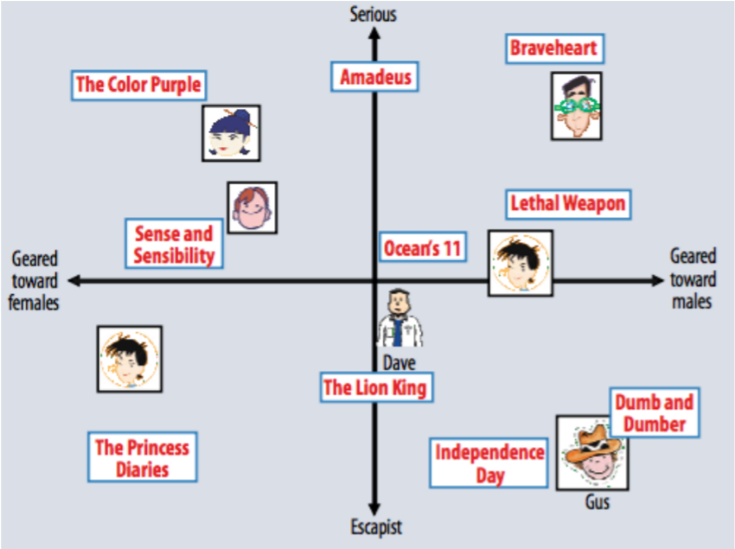
Dimension Reduction to K

Slide 17
Advantages
Better Accuracy
Better Scalability
Linear Time Complexity

Slide 18
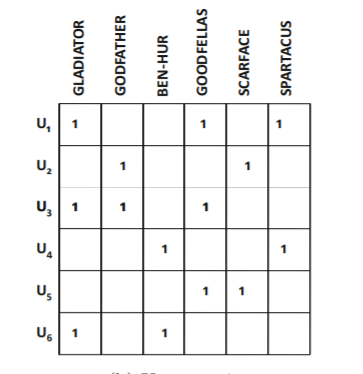


User preference definition:
Confidence level definition: we have minimum confidence in pui for for every user-item pair,but as we have more evidence for positive preference,our confidence in pui=1 increased
Collaborative filtering for implicit user feedback

Slide 19


Preference indicates by:
Minimize the cost function: the term for regularizing:
Collaborative filtering for implicit user feedback

Slide 20
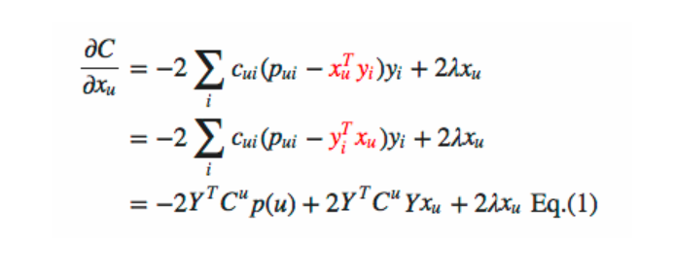
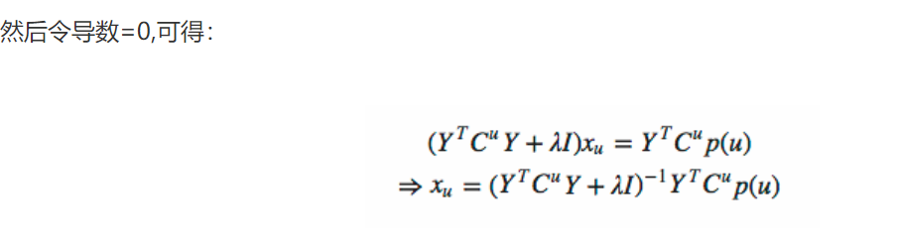
Alternating Least Squares Optimization
Collaborative filtering for implicit user feedback

Slide 21
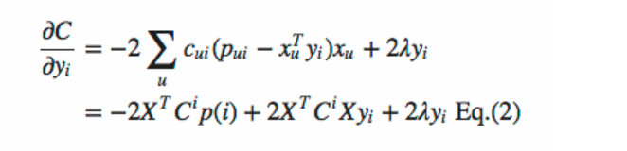
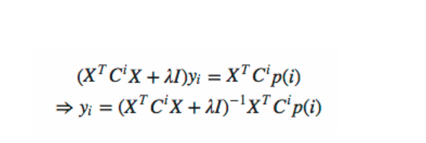
Alternating Least Squares Optimization
Collaborative filtering for implicit user feedback

Slide 22
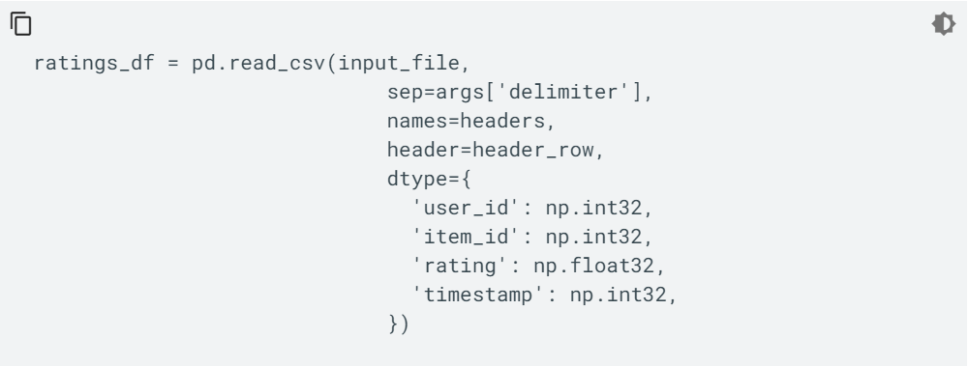
How To Train Model
DATA PREPROCESSING

Slide 23
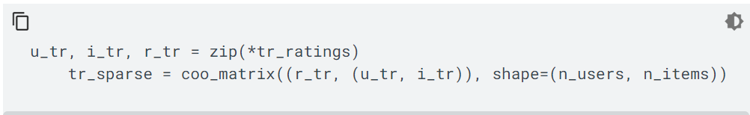
Feature Genereating

Slide 24
Tensorflow:WALS（weight alternating least squares）
用户因子矩阵，位于row.npy
物品因子矩阵，位于col.npy
用户物品交互矩阵行索引和用户ID之间的映射，位于user.npy
用户物品交互矩阵列索引和物品ID之间的映射，位于item.npy
Save Model

Slide 25
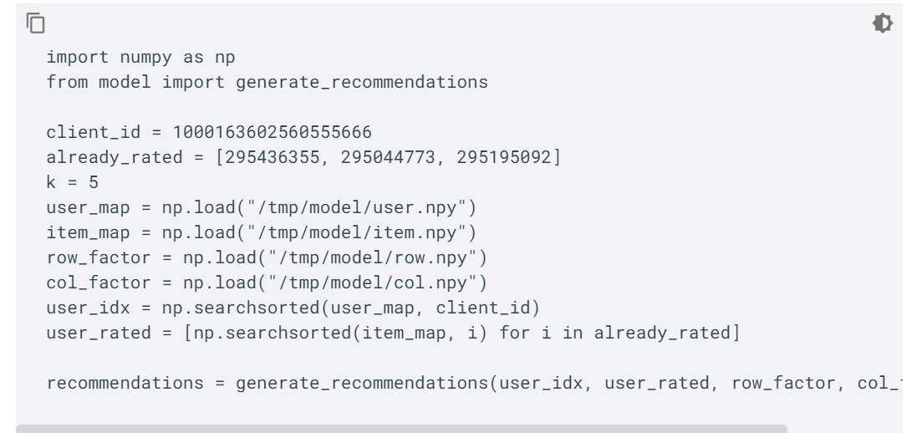

Predict Using Model

Slide 26
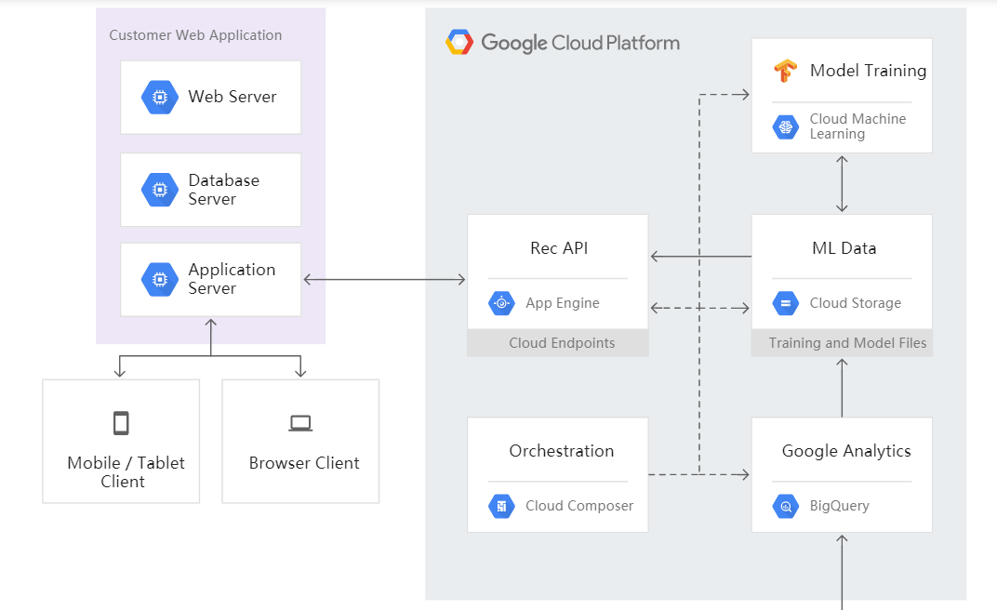
Model Deployment

Slide 27
Conclusions
Take No Efforts to Collect Additional Infomation
Our Recommder System Scales Well With Linearly Time Complexity
The Model We Use Is Very Flexible To Add Other Attributs,For Example Integerates Time Info,Most Recent Behaviour Devotes More To User’s Preference.

Slide 28
THANK YOU

